Slide 1
Robotics
?
Designed For Integrity
The Need For Robotic Assurance
Robert G Parker

Slide 2
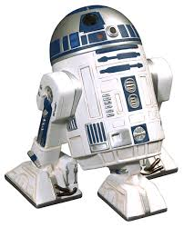
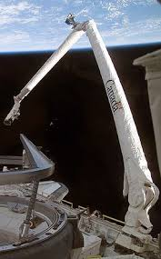
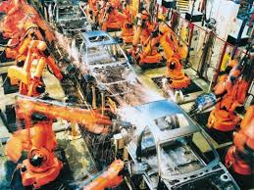
When Considering Robotics, What Do You Think Of?
Science Fiction to Automobile Manufacturing
Robots are a Way of Life

Slide 3
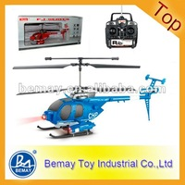
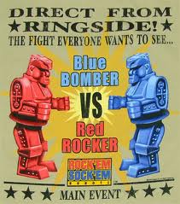
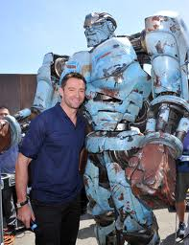
When Considering Robotics, What Do You Think Of?
CH Radio RC Helicopter with Camera
The University of Michigan's biped robot MABEL, for example, can run 6.8 mph and keep its balance while reacting to its environment.
Min. Order: 80 Pieces
FOB Price: US $31.96-48.58 / Piece

Slide 4
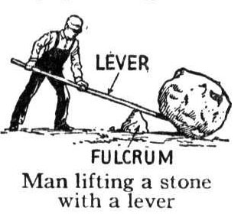
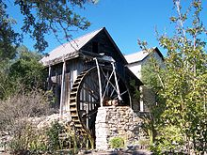
Amplifying Human Productivity
Leveraged Tools
Power Transfer
Simple Tools
Automated Tasks

Slide 5
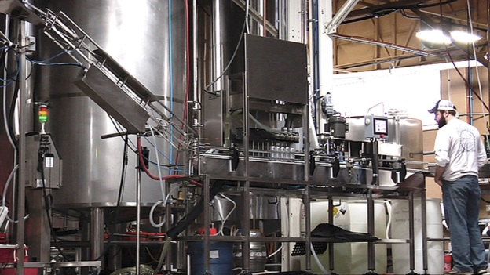
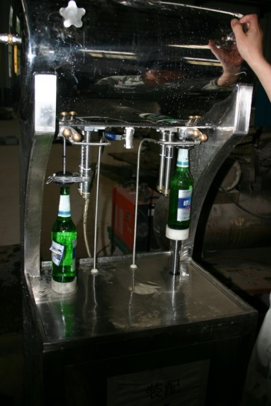
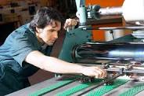
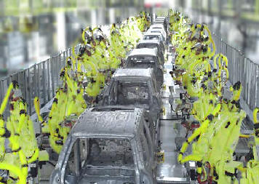
Amplifying Human Productivity
Computer Controlled Processes
Robotic Assisted Processes
Automated Processes
Robotic Controlled Processes

Slide 6
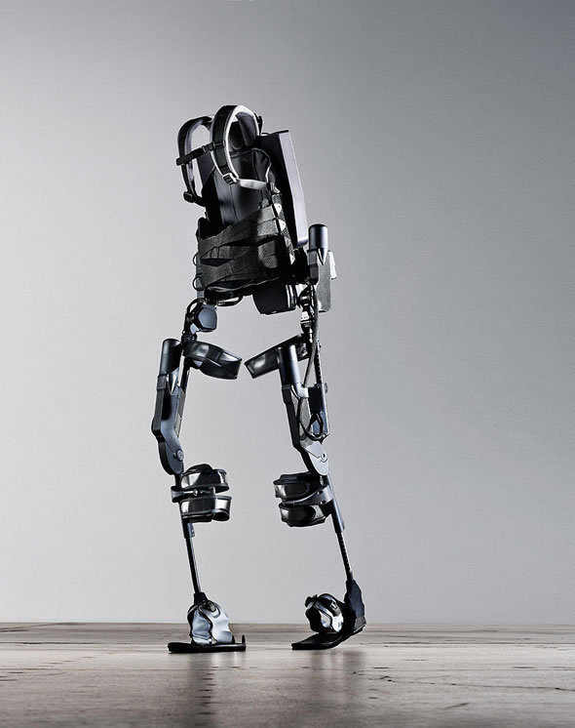
Robotics
Human Augmentation: Ekso Skeleton
Ekso Bionics, a spin-off from Berkeley's robotics lab, has received research grants from the DOD and licensed technology to Lockheed Martin, in connection with its body-enhancing robot, Ekso Skeleton.
Originally intended to help soldiers in the field in terms of strength, endurance, and surviving catastrophic wounds, Ekso Bionics markets its technology commercially as an aid to paraplegics.
Assists Human Movement
Provides Added Strength
Suitable for Paraplegics
Originally From DARPA – Defence Advanced Research Projects Agency

Slide 7
You think running a marathon is tough? Try running a marathon wearing a 40-lb exoskeleton strapped to your lower body. And try doing it without the use of your legs.
It took her 16 days, but 32-year-old Claire Lomas has done it. On May 8, she crossed the finish line of a race that began on April 22, greeted by crowds of supporters as she emerged from under an arch of red balloons at the marathon’s end. Lomas, who is paralyzed from the chest down, wore a “bionic” suit designed to allow people with lower-limb paralysis to walk and stand, which helped her cover about two miles a day.
The ReWalk suit, designed by Israeli firm Argo Medical Technologies, was recently approved by the U.S. Food and Drug Administration (and, TV watchers will note, featured on an episode of Glee) . It costs about $70,000

Slide 8
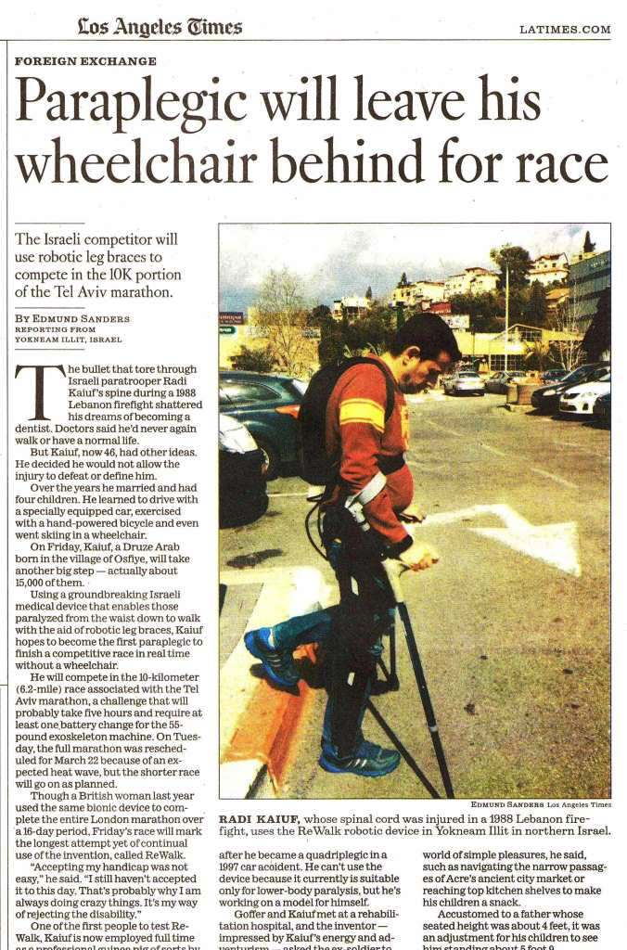
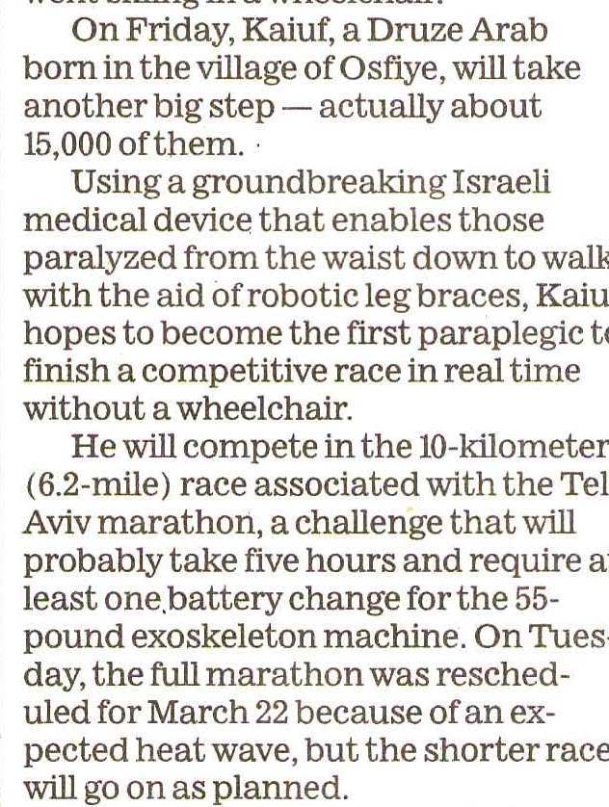
Source: L A Times 2013-05-06

Slide 9
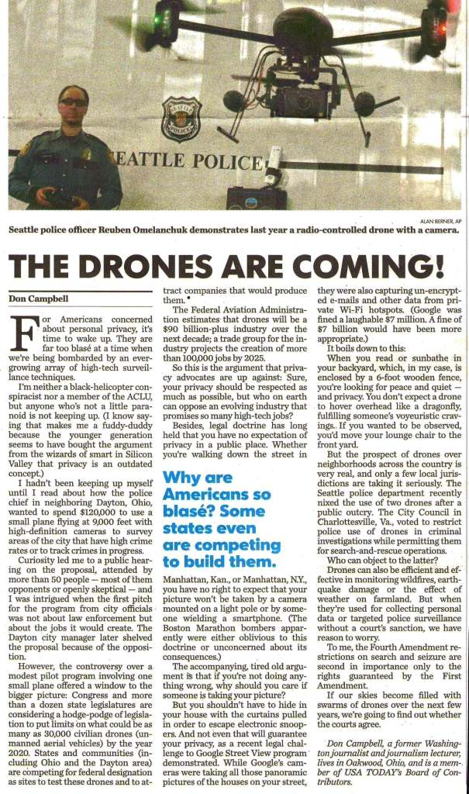
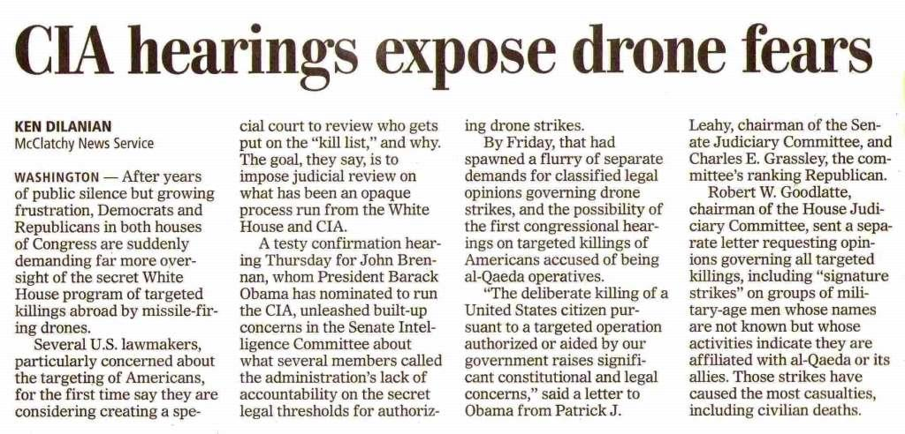
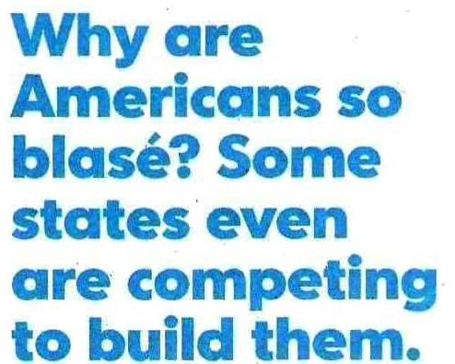
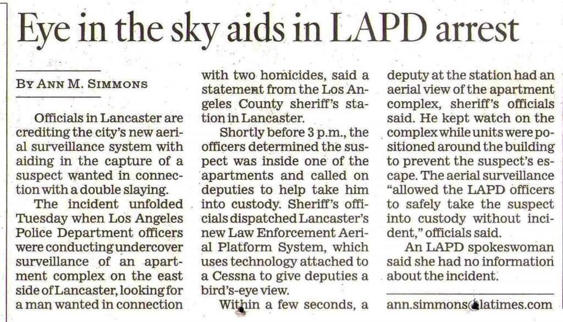
Drones
Source: TC April 2013
Source: USA Today April 1, 2013
Source: LA Times May 13, 2013

Slide 10
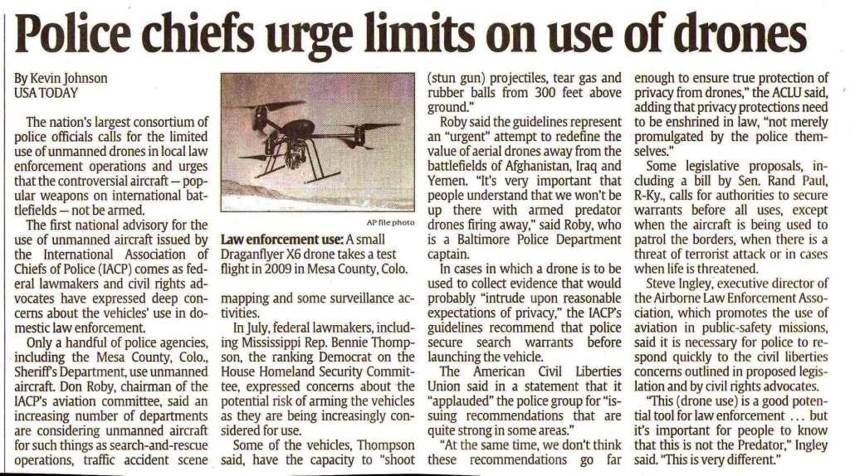
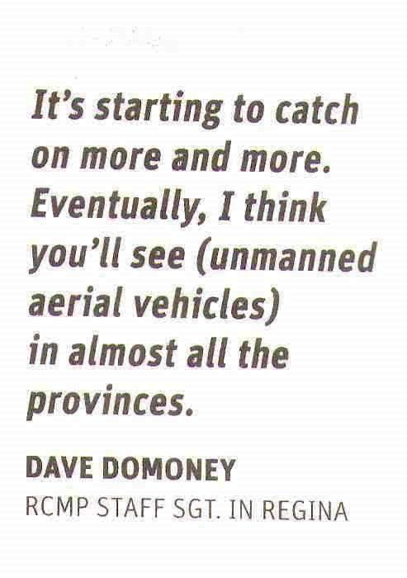
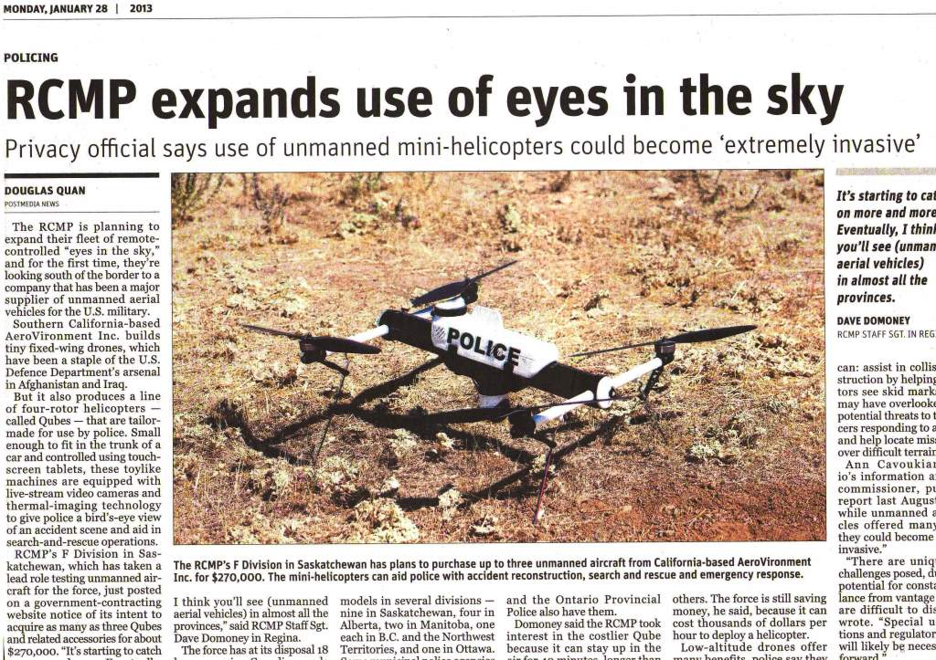
Drones
Police Use
Source USA Today September 7, 2012
Source: TC January 28, 2013

Slide 11
Robotic Activities
Create Documents
Check
Documents
Documents Acted Upon
Results Reviewed
The Computers Check Us
Computer Processes Input
Results (Sometimes ) Checked
Create Input
Computer Checks Input
?
Create Robot Instructions
Robot Interprets Instructions
Robot Executes Instructions

Slide 12
?
Create Robot Instructions
Robot Interprets Instructions
Robot Executes Instructions
Perhaps Humans Have to Check the Robots
Perhaps We Require Some Form of Assurance
We lack standards and requirements for assurance that the robotic devices will perform as intended

Slide 13
In 2013, the 2014 Mercedes S-Class will have the option of autonomous steering, lane guidance, acceleration/braking, parking, accident avoidance, and driver fatigue detection, in both city traffic and highway speeds of up to 124 miles (200 km) per hour.
In 2013, the 2014 BMW i3 will autonomously steer, accelerate and brake in traffic jams at up to 25 miles (40 km) per hour.
By 2014, Volvo expects vehicles that can be autonomous at up to 31 miles (50 km) per hour, with expected use in heavy traffic.
By 2014, Israeli company Mobileye expects to release semi-autonomous car technology.
By 2015, Audi plans to market vehicles that can autonomously steer, accelerate and brake at lower speeds, such as in traffic jams.
By 2015, Cadillac plans vehicles with "super cruise": autonomous steering, braking and lane guidance
By 2015, Nissan expects to sell vehicles with autonomous steering, braking, lane guidance, throttle, gear shifting, and, as permitted by law, unoccupied self-parking after passengers exit.
By 2016, Tesla expects to develop technology that behaves autonomously for 90 percent of distance driven.

Slide 14
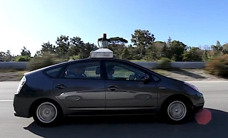
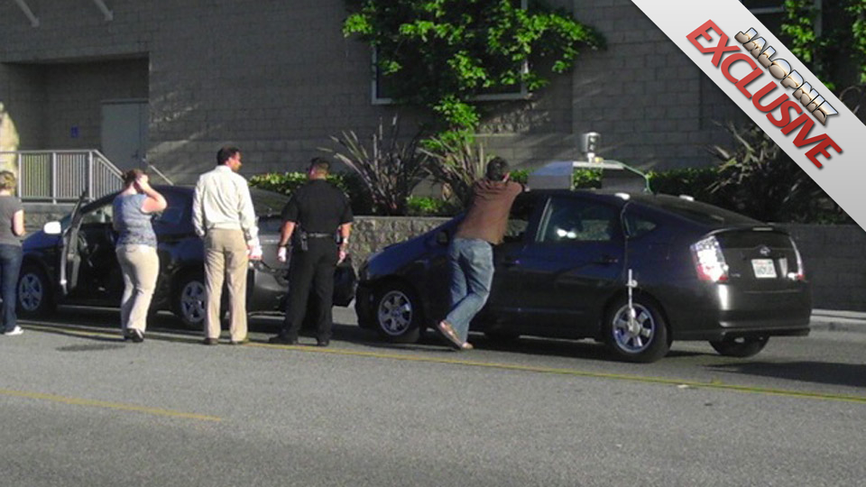
Google Cars
Google can't be hoping to have its software legally blamed for a slice of the traffic crashes that cost more than $160 billion a year in this country. Yet if the operators of Google's self-driving cars retain all legal responsibility, simply turning the system on would be seen in court as a sign they weren't paying attention.
This photo of what looks like a minor case of Prius-on-Prius vehicular violence may actually be a piece of automotive history: the first accident caused by Google's self-driving car. Whose name should the cop write down on the ticket?

Slide 15
Rio Tinto – The Future is Already Here
The autonomous trucks navigate in the complex mining environment and can haul a 320-U.S.-ton payload of overburden and ore without a driver.
At the West Angelas Mine, the trucks are operated and controlled entirely using a supervisory computer at an operations center. In the future, the trucks will be controlled 24 hours a day from a remote operations center located more than 1,000 km (621 mi) away in Perth
Key to the trucks' success is their ability to operate 24 hours a day. (Turns out humans, who need to sleep and use the bathroom and stuff, are really inefficient.) The dump trucks, which communicate wirelessly, navigate using a very precise GPS and can autonomously detect obstacles. They can avoid other vehicles or follow behind them, and are linked to a computer in charge of supervising their actions. Robots overseeing robots! This is the type of job that is ideal for robots to take over from humans: the work is tedious, exhausting, and dangerous. The next step? Rio Tinto is currently testing autonomous drills.

Slide 16
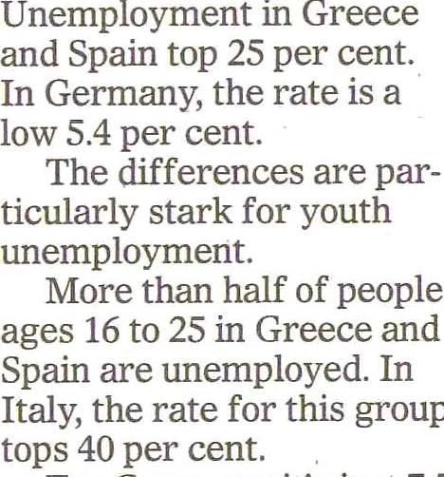
Economic Impact
Source: TC-2013-06-01

Slide 17
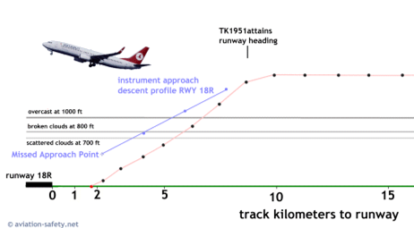
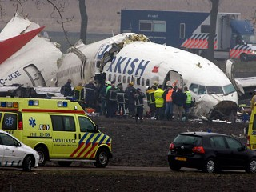
Turkish Airline – Flight 1951
Descending through 8,000 ft
Barometric Altimeter providing Valid Data
Radio Altimeter providing false data (-8 ft)
Radio Altimeter on Pilot's side only
Pilot over-rode false reading
Co-pilot was performing the landing
February 2009
Intercepted the ILS at 1,000 feet – slightly high due to approach requirements
ILS controlled the approach – retarded the throttles for rapid descent
Unknown to the crew the ILS was reading the Pilot’s radio altimeter at -8 ft.
ILS set the engines to full retard - idle (assuming they were on the ground)
The results were

Slide 18
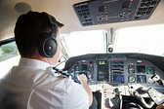
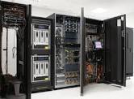
Who Was at Fault ?
Pilot
Computer
In the report there is heavy criticism of aircraft manufacturer Boeing, which built the 737 and was aware of problems with the radio altimeters. (2,500 reports)
Boeing in 2004 added a warning in the 737-800 dispatch deviation guide that an autopilot or auto-throttle must not be used during approach and landing if its associated radio altimeter is found to be inoperative before the flight begins. However, the report noted that the aircraft’s quick reference handbook and flight crew operating manual do not contain similar guidance for a radio altimeter malfunction that occurs during flight.

Slide 19
Who Was at Fault ?
The radio altimeter system did not operate correctly causing anomalous behaviour of the automatic flight system and other systems on the aircraft during flight TK1951.
The approach of flight TK1951, where the auto-throttle functioned as though immediately before landing on the basis of incorrect radio altimeter system data, while the other part was still actively flying (the right autopilot was following the glide slope signal), presented the crew with an automation surprise that cannot be traced in the Boeing 737 books or training courses.
The word ‘RETARD’ appeared on the flight mode annunciation of both primary flight displays.
The flight could have been continued safely in such a situation if the pilots had intervened on time by any of the following methods:
• Pressing the TO/GA button on the thrust levers to initiate a go-around.
• Advancing the throttles and keep them in position manually.
• Deactivating the auto-throttle (and possibly the right autopilot) and taking over control manually.

Slide 20
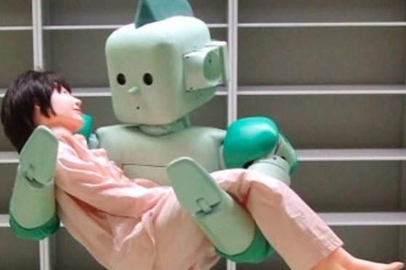
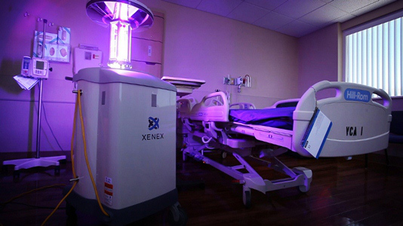
Medical Robots will replace care givers in turning patients over, carrying them from their beds to chairs or gurneys and moving beds around the hospital
Japanese Nursing Assistant
Robot
Sterilization Robots will Clean and Disinfect Rooms

Slide 21
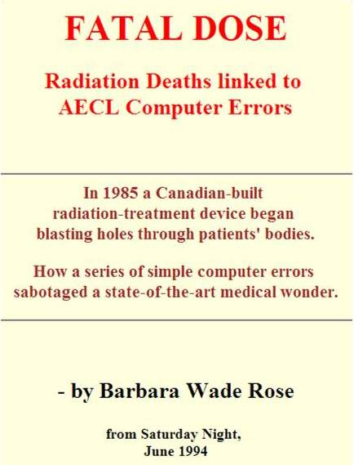
The Need For Assurance
Therac-25
On March 21, 1986, oilfield worker Ray Cox visited a clinic in Tyler, Texas, to receive his radiation treatment. Cox knew from his previous visits that the procedure should be painless--but that day, he felt a jolt of searing heat. Outside the shielded treatment room, the therapy technologist was puzzled. The computer terminal used to operate the radiation machine displayed the cryptic message, "Malfunction 54," indicating the incorrect dose had been delivered. Clinic staff were unable to find anything wrong with the machine, so they sent Cox home and continued treating other patients.
Four days later, "Malfunction 54" flashed on the screen again during a treatment, this time while a sixty-six-year-old bus driver, Verdon Kidd, was receiving therapy at the Tyler cancer centre for skin cancer on his face. He became disoriented and then comatose, and died three weeks later. Kidd's death, which preceded Cox's by nearly four months, made medical history -- the first fatality caused, according to Jacky's research, by an overdose during radiation treatment.
?

Slide 22
v
We Need Robotic Assurance

Slide 23
Robotic Standards
Asimov - 1950s Science Fiction
ISO/IEC – Various Standards
NIST - Some Standards
Korea – Updated 2012 Manufacturing Robots
Japan - Ten Principles of Robotic Law

Slide 24
Robotic Standards
Asimov
Asimov’s Three Laws of Robotics
A robot may not injure a human being or, through inaction, allow a human being to come to harm.
A robot must obey any orders given to it by human beings, except where such orders would conflict with the First Law.
A robot must protect its own existence as long as such protection does not conflict with the First or Second Law.

Slide 25
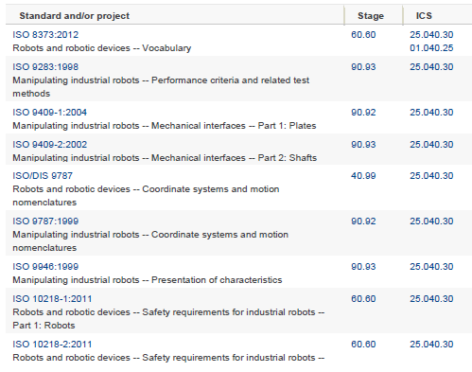
Robotic Standards
ISO/IEC

Slide 26
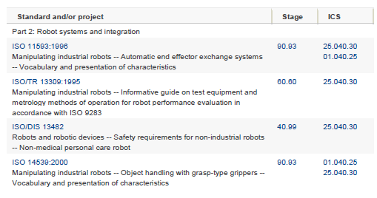
Robotic Standards
ISO 10218:2011 standard for robot manufacturers and integrators.

Slide 27
Robotic Standards
NIST - ANSI
Developed by Robotic Industries Association (RIA), the ANSI/RIA R15.06-2012 standard has been updated for the first time since 1999 and is now harmonized with the International ISO 10218:2011 standard for robot manufacturers and integrators.
ISO 10218:2011 standard for robot manufacturers and integrators.
Standards on Calibration
October 21-23 2013 Conference Towards Mobile Manipulator Safety Standards

Slide 28
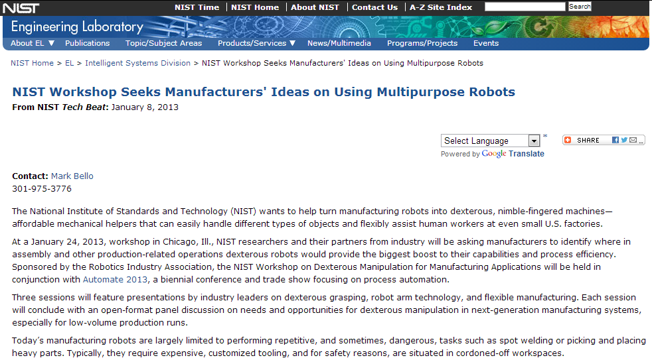
Robotic Standards
NIST - ANSI
Repetitive Tasks
Customized Tooling
Limited Human Access

Slide 29
Robotic Standards
Korea – South Korean Robot Ethics Charter 2012
Part 1: Manufacturing Standards
A-Limit autonomy of robots – Always possible for humans to assume control
B -Manufacturing QA– Minimize injury or death – community safety guaranteed
C –Manufacturers ensure risk of psychological harm to users is minimized
D–Manufacturers ensure product is identified and identity not changed
E–Robots designed to protect personal data – encryption, secure storage
F–Robots designed so all their actions (on-line & real world) are traceable at all times
G–Robots design must be ecologically sensitive and sustainable

Slide 30
Robotic Standards
Korea – South Korean Robot Ethics Charter 2012
Part 2: Rights & Responsibilities of Users/Owners
Section1: Rights and Expectations of Owners and Users
1-Owners have the right to be able to take control of the robot
2-Owners & users have right to use robot without fear of physical/psychological harm
3-Users have right to security of their personal details and sensitive information
4-Owners & users have right to expect robot will perform any task for which it has been explicitly designed (Subject to Section 2)

Slide 31
Robotic Standards
Korea – South Korean Robot Ethics Charter 2012
Part 2: Rights & Responsibilities of Users/Owners
Section2: Responsibilities of Owners and Users
1-A user must not use a robot to commit an illegal act
2-A user must not use a robot such that it may cause physical or psychological harm
3-An owner must take reasonable precautions to ensure the robot does not pose a threat to safety and well being of individual or their property

Slide 32
Robotic Standards
Korea – South Korean Robot Ethics Charter 2012
Part 2: Rights & Responsibilities of Users/Owners
Section3: Offences Under Korean Law
1-To deliberately damage or destroy a robot
2-Through gross negligence , to allow a robot to come to harm
3-It is a lesser but nonetheless serious offence to treat a robot in a way which may be construed as deliberately and inordinately abusive

Slide 33
Robotic Standards
Korea – South Korean Robot Ethics Charter 2012
Part 3: Rights & Responsibilities For Robots
Section1: Responsibilities of Robots
1-A robot may not injure a human or, through inaction , allow a human to come to harm
2-A robot must obey any orders given to it by human beings, except where such orders would conflict with Part 3, section 1, subsection 1 of this Charter
3-A robot must not deceive a human being

Slide 34
Robotic Standards
Korea – South Korean Robot Ethics Charter 2012
Part 3: Rights & Responsibilities For Robots
Section2: Rights of Robots
Under Korean Law, Robots are afforded the following fundamental rights:
1- The right to exist without fear of injury or death
2-The right to live an existence free from systematic abuse
The document above is a mock-up of what the South Korean Robot Ethics Charter (currently being drafted) may look like in the future, based on the limited information about the charter available from media reports

Slide 35
Robotic Standards
Japan – “Ten Principles of Robot Law - circa 2010
1. Robots must serve mankind
2. Robots must never kill or injure humans
3. Robot manufacturers' shall be responsible for their creations
4. Robots involved in the production of currency, contraband or dangerous goods, must hold a current permit.
5. Robots shall not leave the country without a permit.
6. A robots identity must not be altered, concealed or allowed to be misconstrued.
7. Robots shall remain identifiable at all times.
8. Robots created for adult purposes shall not be permitted to work with children.
9. Robots must not assist in criminal activities, nor aid or abet criminals to escape justice.
10. Robots must refrain from damaging human homes or tools, including other robots.
These principles are adapted from the original “Ten Principles of Robot Law” formulated by Osamu Tezuka for his Astro Boy series.

Slide 36
?
v
We Need Robotic Assurance
v
We Need Robotic Standards Against which to Assess Compliance and Obtain Assurance
Management Standards
Technical Standards
Standards
Device/Class Specific
Process Specific
Results Specific – Must Do Something
Time Specific
Policies
Procedures
Processes
Monitoring
Objective - Unbiased
Measureable
Complete
Relevant

Slide 37
ISO 13482 – Robots and robotic devices - Safety requirements for service robots - Personal care robot
An Annex now provides exemplar risk assessment for different robot types. In addition, minimal required performance levels according to ISO 13849-1 are specified in the main text.
Management Umbrella
Tech-1
Tech-2
Tech-3
Tech-4

Slide 38
v
We Need Robotic Assurance
?
v
We Need Robotic Standards Against which to Assess Compliance and Obtain Assurance
v
We Need A Taxonomy Under Which Robotic Standards Can Be Developed
v
We Need Metrics for Each Standard
Against Which Compliance Can be Measured

Slide 39
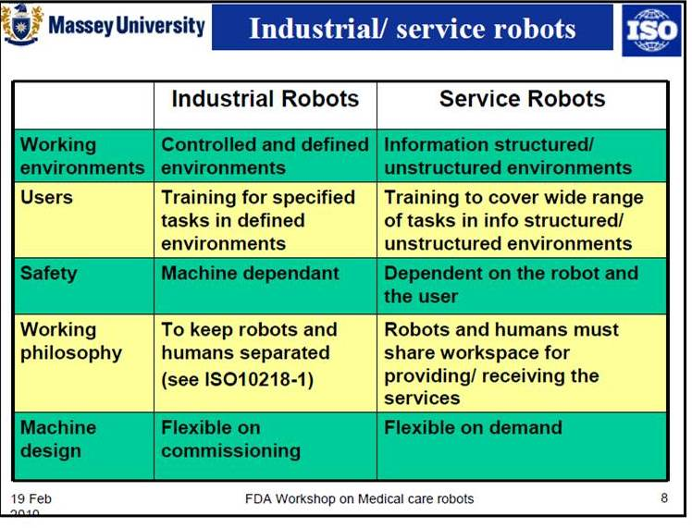
Sample Robotic Classification

Slide 40
Where do we go from here?
Develop a
Conceptual Structure
Establish Draft Development Terms & Taxonomy
v
Project Management
v
Consider and Determine Alliances
ISO/IEC
Accounting
Engineers
IT Audit
Map to Available Guidance
v
v
v
Perform Gap Analysis
Conduct a Pilot Project
Proof of Concept
v
Assess Results
Consider Next Steps
Establish an Approach for Development
v
Develop a Robotic Assurance Integrity Model

Slide 41
Robotic Assurance Integrity Model
Integrity Component Objectives
Integrity Component Techniques

Slide 42
Integrity Component Objectives
Ensure the robotic instructions are executed in accordance with the approved detailed design
Accuracy
Completeness
Ensure the robotic instructions are complete with respect to the specific task required
Relevance
Ensure the robotic instructions incorporate relevant task, situational or other environmental considerations or references
Authorized
Ensure the robotic instructions are approved prior to their use within robotic devices
Timeliness
Ensure the robotic instructions are executed in a timely manner, in the correct sequence with consideration of related activities
Security
Ensure the robotic instructions may not and have not been compromised or otherwise modified
Integrity
Ensure the robotic instructions require acknowledgement and approval of each individual task as completed

Slide 43
Integrity Component Techniques
Multiple processes, multiple processing paths, results compared and agreed prior to processes continuing
Accuracy
Completeness
Predefined common tasks, industry standards, common scripting and common links (Perhaps dealing with movement, etc.)
Adoption of information lifecycle techniques, relate actions to tasks, situations, environment. Combine information from multiple sensors
Relevance
Authorized
Initial handshake, confirming channels, referencing instructions, encryption
Timeliness
Delayed message timeout; resend required , positive message sequencing (tested not assumed)
Security
Message authentication, encryption, etc.
Integrity
Acknowledgement and approval of task completion

Slide 44
Robotic Assurance
Are We Too Late?

Slide 45
British scientist Kevin Warwick
is determined to meld man and machine
Twelve years ago, Warwick declared he was on a mission to become the world’s first man-turned-machine
Surgeons inserted a glass capsule containing several micro- processors into Warwick’s arm, and for the next nine days his presence was recorded by computers throughout the university’s cybernetics department.
When Kevin was connected to the internet, if you had known the IP address of his nervous system… But what they did is not tell anybody what they were doing until they had done it. Careful not to get your nervous system spammed or hacked! Output from the sensors fed to his nervous system (fancy thing on his wrist)
When an object came closer, his brain received an increased frequency of ultrasounds (?). So basically with a blindfold on, Kevin was able to move around and detect objects pretty accurately. Not what they were, but where they were.
“It felt like something was coming close to me.” Extended the sensory range. Like “what does it feel like to see something”

Slide 46
Rat brain robot
Prof Warwick’s research created the ‘rat brain robot’ with a biological brain. He cultured brain cells directly on to a recording surface and then re-embodied the ‘brain’ within a robotic body. The robot made decisions based on information coming in.
A baby robot at two hours old clearly hadn’t yet learned what its function is. It was supposed to be able to detect a wall and change direction to avoid hitting it, but at such a young age it made lots of mistakes.
Two to three months on the robot had learned from its mistakes. Film of a two month-old robot showed that it had perfected the art of not bumping into the wall. Under the microscope scientists could see how the neural connections developed. The rat brain robot has a purely biological brain, with no computer involved.
At the moment, says Prof Warwick, the best neuron-brain robots we can build have, with tens of thousands of brain cells, the intelligence of a bee or a wasp. This is still nowhere near the 100 billion neurons present in a human brain, although researchers are now using human neurons in robots.

Slide 47
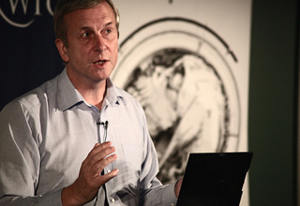
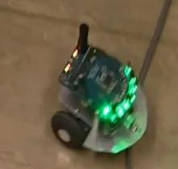
Prof Warwick is no stranger to using himself as a guinea pig for his research. One experiment, which previously had only been tested on chickens, involved him undergoing a two hour operation by a neurosurgeon to implant a ‘brain gate’ system in him, linking his nervous system with a computer.
The implant in his arm had wires running to a connector. A computer monitored the signals between his brain and arm. Prof Warwick’s brain learned to recognise the system of pulses emitted during the three months of the experiment. He was able to turn on lights and control a wheelchair via the implant.
His wife also had a connector implanted. Every time she moved Prof Warwick’s brain received a signal.
It was the first time people had electronically communicated by thought alone.

Slide 48
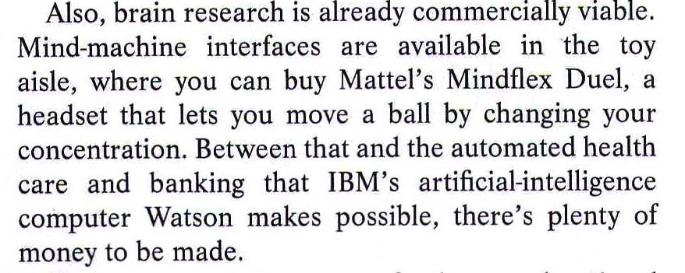
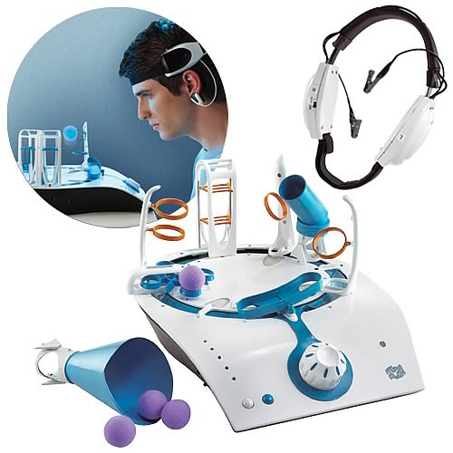
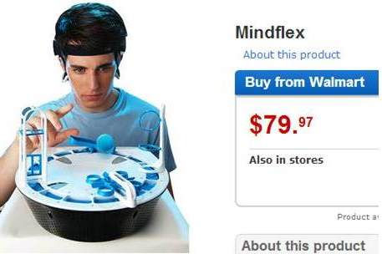
Technology
There are Good News Stories
Robotic Mind Control

Slide 49
When one starts into some form of human-like robotics the dynamics are considerably changed
For example, concepts of ethical behaviour, different outcomes from performing the same task (depending on the mood, level of concentration, distractions, etc. and the robot’s environment), legally, is the robot now a person, and so forth
If we consider that, how do we apply robotic laws, standards and best practices

Slide 50
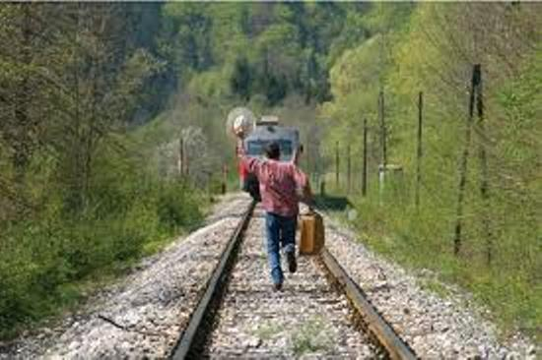
Robotic Assurance
With Human Like Robots
Hopefully The Assurance Train Has Not Left The Station

Slide 51
We have
Data
Thoughts
Model Components
Next Steps
Develop a Robotics Integrity Model
We would appreciate your:
Thoughts
Comments
Input

Slide 52
Thank You For Your Interest and Participation
Robert G Parker
MBA, FCPA, CPA•CA, CISA, CRISC, CMC

