Slide 1
Panel 2: Audit Data Standards
The Standards Landscape
Toronto 2 October 2015

Slide 2

Who I am
Eric E. Cohen
XBRL Technical Leader, PwC
Co-founder of XBRL, founder and chief architect of XBRL GL
Chair, ANSI Technical Advisory Group to ISO/PC 295
Member, AICPA Audit Data Standards TF
Domain coordinator for Accounting and Audit standards, UN-CEFACT
Participant in development of OECD Standard Audit File – Taxation
Advisor to Swedish SIE Group
Liaison to numerous other standards groups
Author of first article about the Internet for JOA and first book for Accountants

Slide 3
Topics
News briefing on ADS
Broader standards world focusing on ISO/PC 295
AICPA Analytics vision using standards

Slide 4

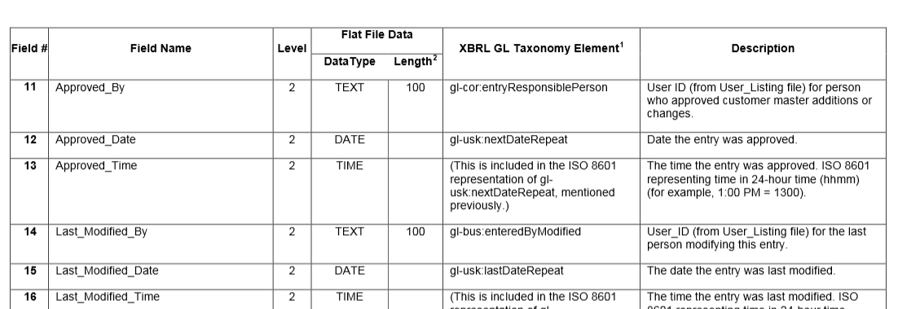
Audit Data Collection Standardization
AICPA Audit Data Standard (July 2015)
  New O2C and P2P
  Update
  http://www.aicpa.org/InterestAreas/FRC/AssuranceAdvisoryServices/Pages/AuditDataStandardWorkingGroup.aspx

Slide 5
News Briefing: AICPA Audit Data Standards
In progress: Inventory
Getting started: Fixed Assets
Looking for prioritization of new modules, industry specialization, deeper dives for internal audit and operational benefits
Outreach to ISO/PC 295

Slide 6
Audit Data Standards Landscape
    UN/CEFACT Core Components library and Naming and Design Rules and accounting documents ( ACCOUNT, ENTRIES, CHACCO, JOURNAL, etc.)
    ANSI X.12 accounting transactions (EDI 821 Financial Information Reporting Transaction Set)
    OECD Standard Audit File - Tax, SAF-Payroll
    Swedish Standard Import Export (SIE)
    Dutch Auditfile Financiel
    OMG GL facility, AR/AP facility
    OAGIS platform
    XBRL GL
    Proprietary mandatory bookkeeping format for specific regulatory and regional purposes

Slide 7
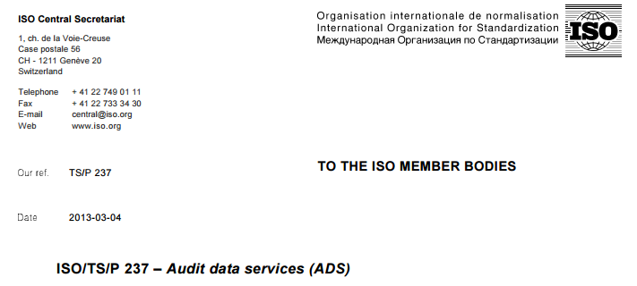
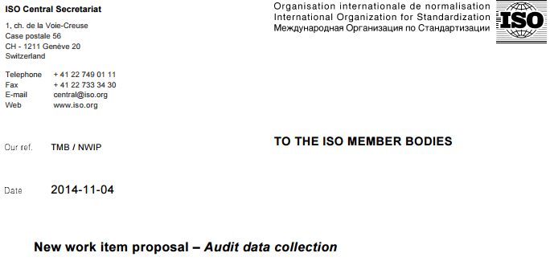
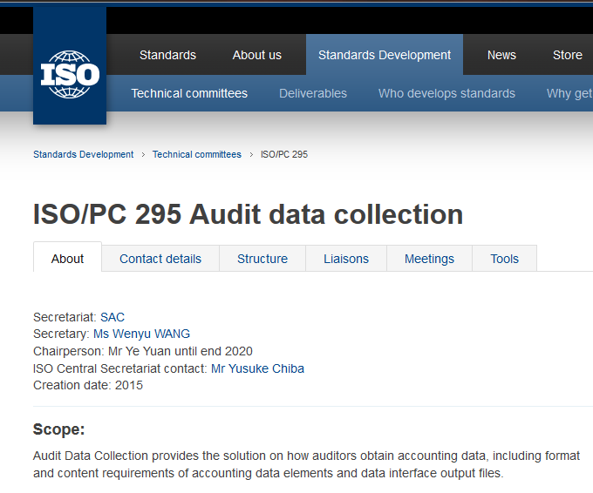
Audit Data Collection Standardization
ISO/PC 295
  Timeline
3/2013: ISO/TC/P 237 Proposal
6/2013: Insufficient support
6/2014: Revised plan
11/2014: NWIP
2/2015: ISO/PC 295
4 months out
6 weeks out
3-4 November
3 years forward

Slide 8

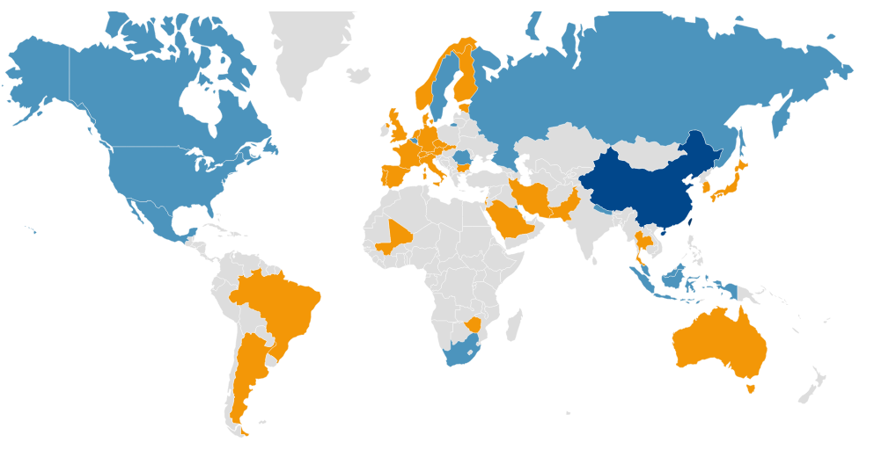
Audit Data Collection Standardization
ISO/PC 295
  Response
    XII POV
    P and O countries
    XII TF and Liaison

Slide 9
Audit Data Collection Standardization
ISO/PC 295
  Goals and deliverables

Slide 10
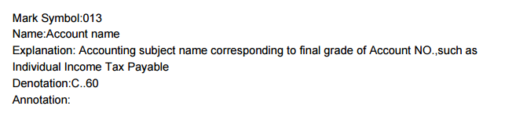
Audit Data Collection Standardization
ISO/PC 295
  Existing working draft
    Inventory of concepts

Slide 11
Audit Data Collection Standardization
ISO/PC 295
  Existing working draft
    Inventory of concepts (cont.)
Item | Purpose
Mark symbol | Unique identified
Name | Concept name
Explanation | Description
Denotation | Data typing and limitations
Annotation | Relevant business rule

Slide 12
Audit Data Collection Standardization
ISO/PC 295
  Existing working draft
    Areas of data exchange
Electronic book data file Output: One Time
Accounting item data file Output: One Time
Accounts balance and amount occurred data file Output: By Month
Accounting voucher data file Output: One Time
Balance Sheet data file Output: By Month
Profit Statement data file Output: By Month
Cash flows Statement data file Output: By Month
Cash flows Statement(small business) data file Output: By Month
Value added tax payable sheet Output: By Month
Asset Impairment losses sheet Output: By Year
Statement of owner's equity Output: By Year
Profit appropriation statement Output: By Year
Non-profit undertakings balance sheet Output: By Month
Non-profit undertakings revenue & expenditure sheet Output: By Month
Non-profit undertakings detail statement of expenditure Output: By Month
Non-profit undertakings detail statement of operating expenditure Output: By Month

Slide 13
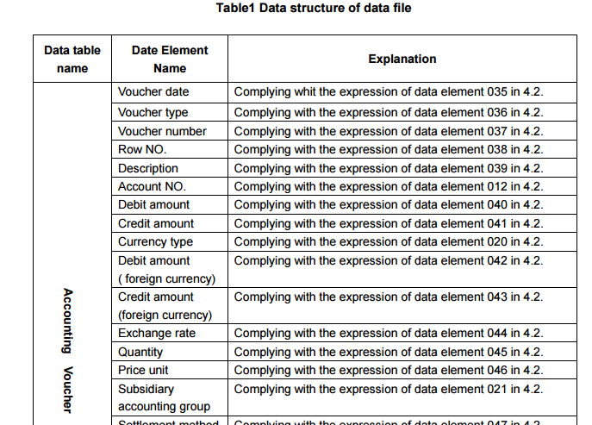
Audit Data Collection Standardization
ISO/PC 295
  Existing working draft
    Representation of area with inventory items

Slide 14
Audit Data Collection Standardization
ISO/PC 295
  Call to Action
    XII TF as central point to develop response
    National ISO rep activities to develop local response
    Beijing 3-4 November to contribute to foundation for three year effort
    NEED YOUR INPUT

Slide 15
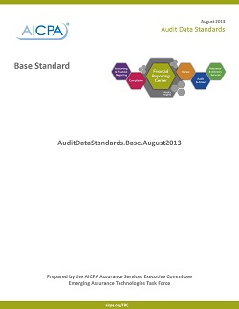
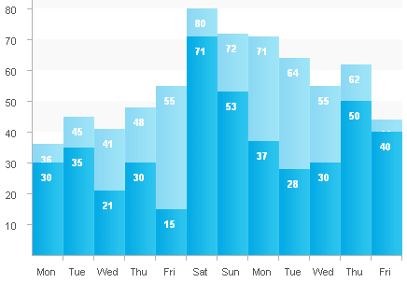
Possible Automated Analytics Vision
AICPA
Audit Data Standards
Methodology/Framework
Industries
Base
Specific Topic
White Papers
&
Guidance Documents
O2C
Processes
P2P
INV
…
Assertions
Audit Apps
Transaction Volume
Version: 1.2
Author: Ryan Teeter
Auditco, llc.
Platform: ACL 9.1, SAP
Timing: Weekly
Method: Automatic
Location: Remote
Download Now
Description
Transaction Volume evaluates the total number of transactions passing through any given module and compares it against prior weeks. Date range and SAP module can be customized.
Assertions Reviews
Completeness
Crowd
Source

